Slide 1
Physical and Social Predictors of Health Outcomes By Elizabeth Vandergrift, Juan Camilo Bohorquez Rozo, and Eric Croston

Slide 2
Physical and Social Predictors of Health Outcomes
Data Review
Correlations
Machine Learning
Visualizations

Slide 3

Social Determinants of health
Data Source:
US Department of Health and Human Services and CDC
PLACES: County Data 2023 release https://data.cdc.gov/500-Cities-Places/PLACES-County-Data-GIS-Friendly-Format-2023-releas/7cmc-7y5g/about_data

Slide 4

Information about Data used in this project
PLACES: County Data 2023 release :
Covers the entire United States, by state and county level
Centers for Disease Control and Prevention (CDC)- Division of Population Health, Epidemiology and Surveillance Branch.
Data sources:
System (BRFSS) 2021 or 2020 data Behavioral Risk Factor Surveillance
Census Bureau 2021 or 2020 county population estimates
American Community Survey (ACS) 2017–2021 or 2016–2020 estimates
Healthy People 2030, U.S. Department of Health and Human Services, Office of Disease Prevention and Health Promotion. Retrieved [date graphic was accessed], from https://health.gov/healthypeople/objectives-and-data/social-determinants-health
http://www.cdc.gov/nccdphp/dph/

Slide 5

what are factors that could lead to chronic disease and disability? How can we improve our health outcomes in the United States?

Slide 6
Social Determinants of health
The nonmedical factors that influence health outcomes
Housing, Income, Education and overall conditions of a person’s environment can impact their functioning, quality of life and health outcomes

Slide 7
Food Access
Food Insecurity and Malnutrition
Impact of Food Deserts
Obesity and Chronic Disease
Cognitive Impacts and Mental Health
Access to Food and Proper Nutrition Impacts Health Outcomes

Slide 8
What are chronic health conditions, diseases and disabilities that could be influenced by SDOH
Is Health Screening and Prevention Impacted by SDOH?

Slide 9
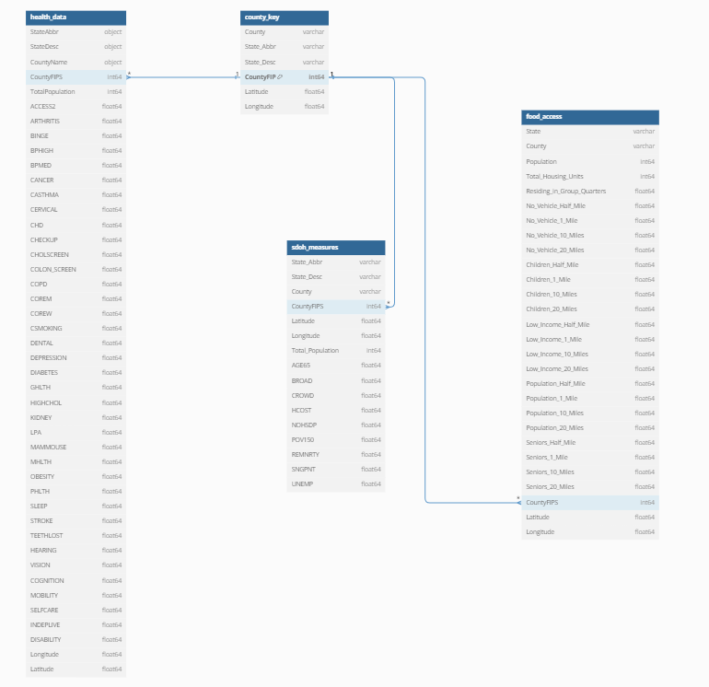
Connecting the Data in Postgres SQL database Entity Relationship Diagram
County FIP- A specific ID for each State and County used in government datasets

Slide 10
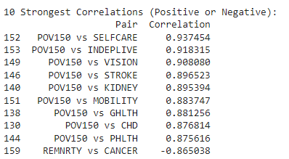
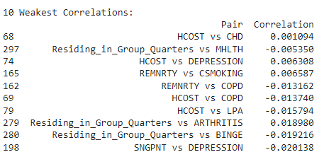
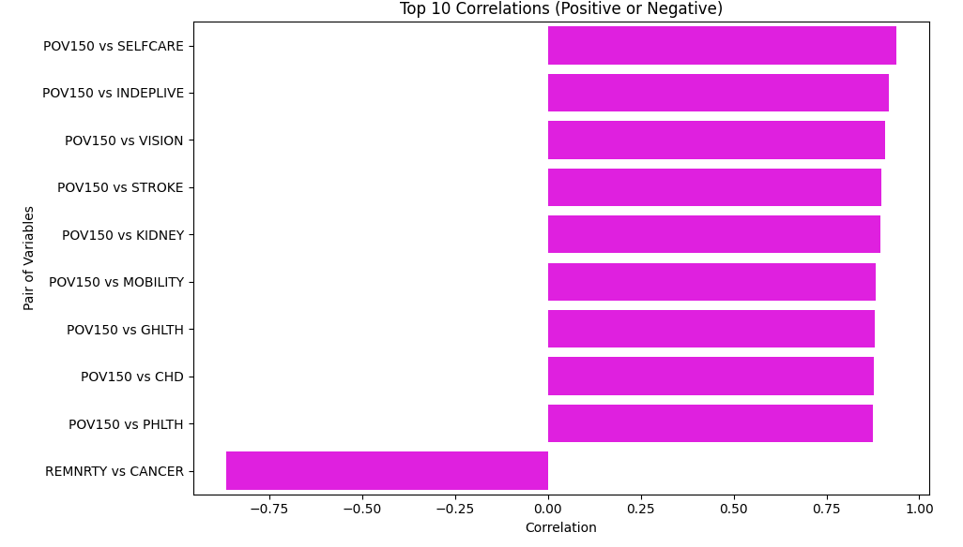
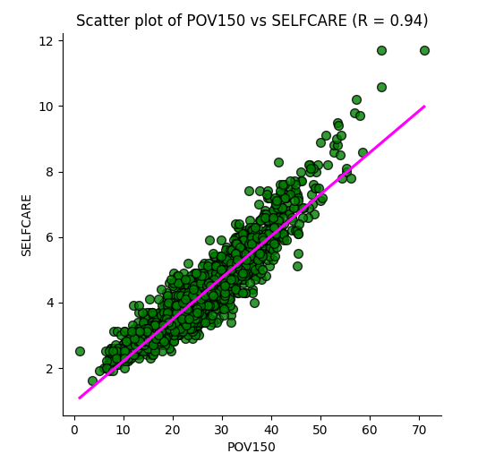
Correlations Social Determinants of Health Outcomes
10 Strongest and Weakest Correlations
For a single person in 2024, 150% below FPL is $14,580 and 150% of that would be $21,870
Strongest and Weakest Correlations Positive or Negative

Slide 11
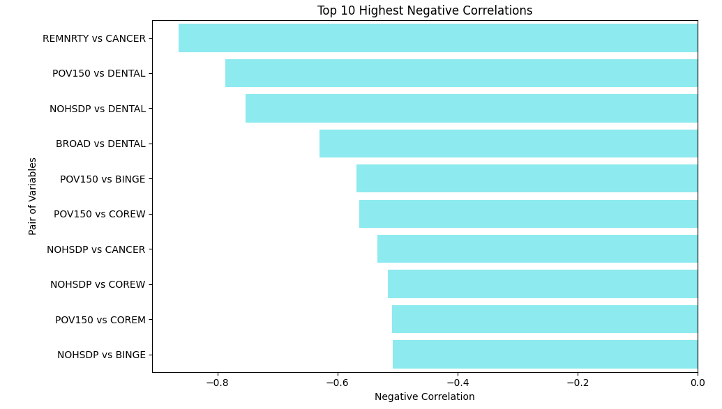
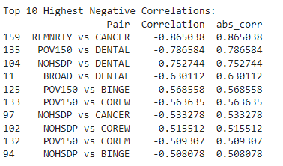
Correlations Social Determinants of Health Outcomes
10 Strongest Negative Correlations
Strongest and Weakest Correlations Positive or Negative

Slide 12
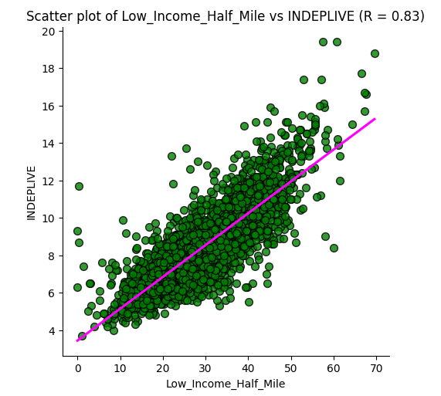
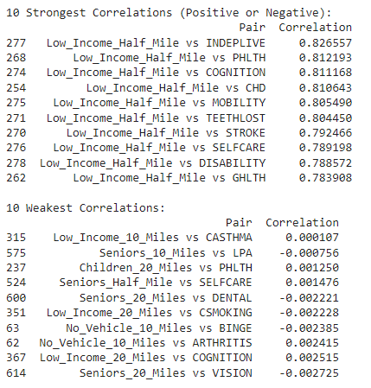
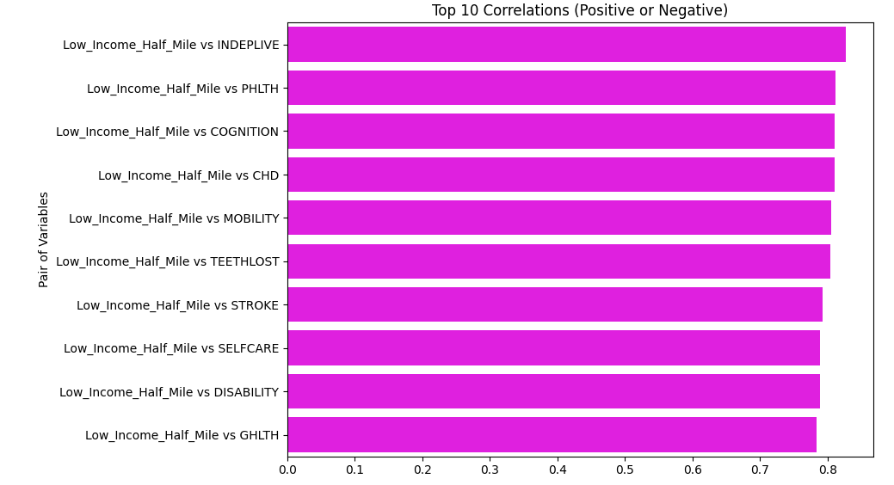
Correlations Food Access and Health Outcomes
10 Strongest Correlations
Strongest and Weakest Correlations Positive or Negative

Slide 13
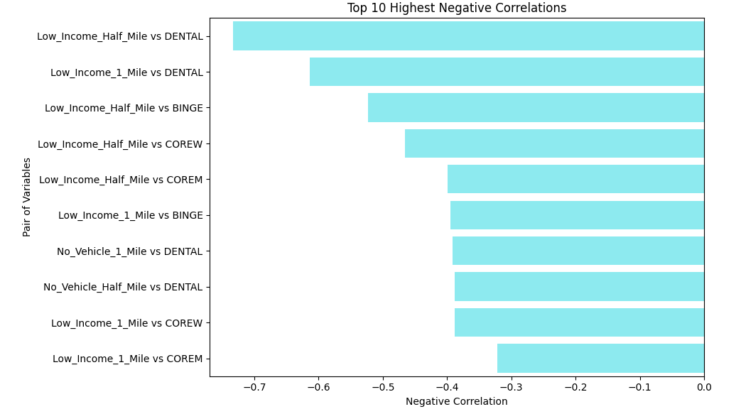
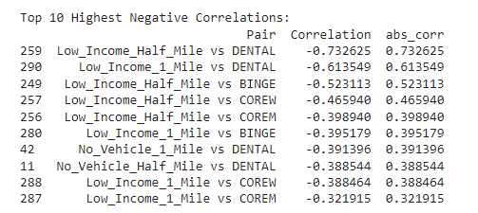
Correlations Food Access and Health Outcomes
10 Strongest Negative Correlations
Strongest and Weakest Correlations Positive or Negative

Slide 14
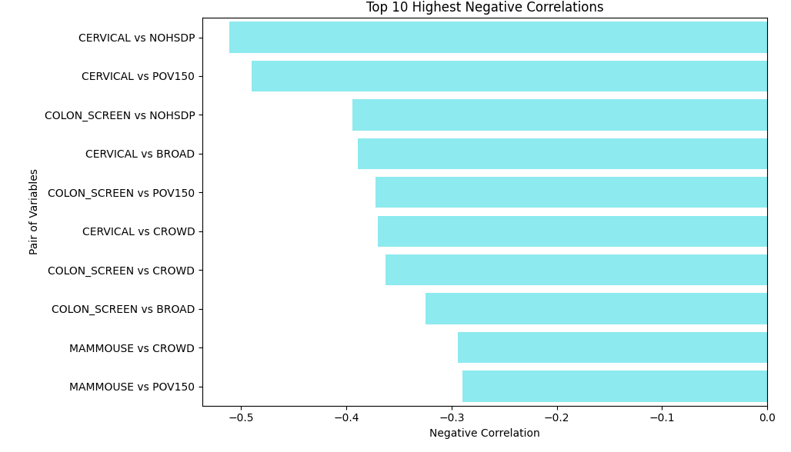
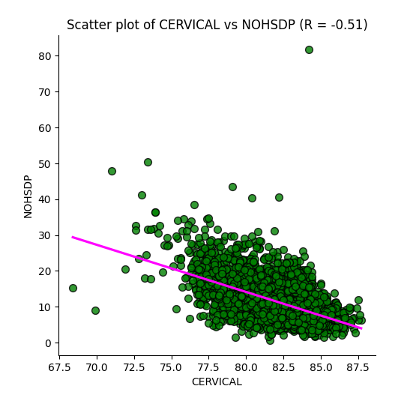
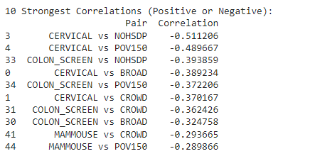
Correlations Preventative Screenings and SDOH
10 Strongest Negative Correlations
Strongest and Weakest Correlations Positive or Negative

Slide 15
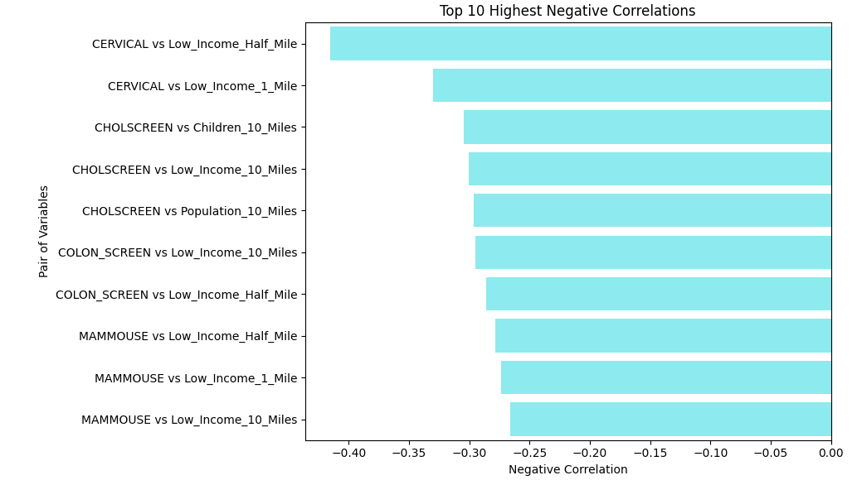
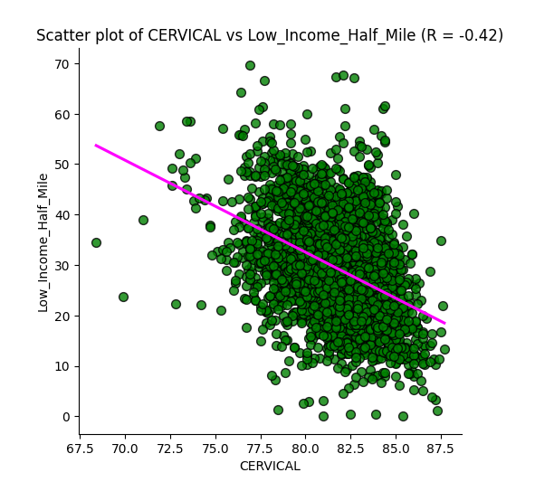
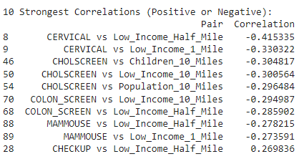
Correlations Preventative Screenings and food Access
10 Strongest Negative Correlations
Strongest and Weakest Correlations Positive or Negative

Slide 16
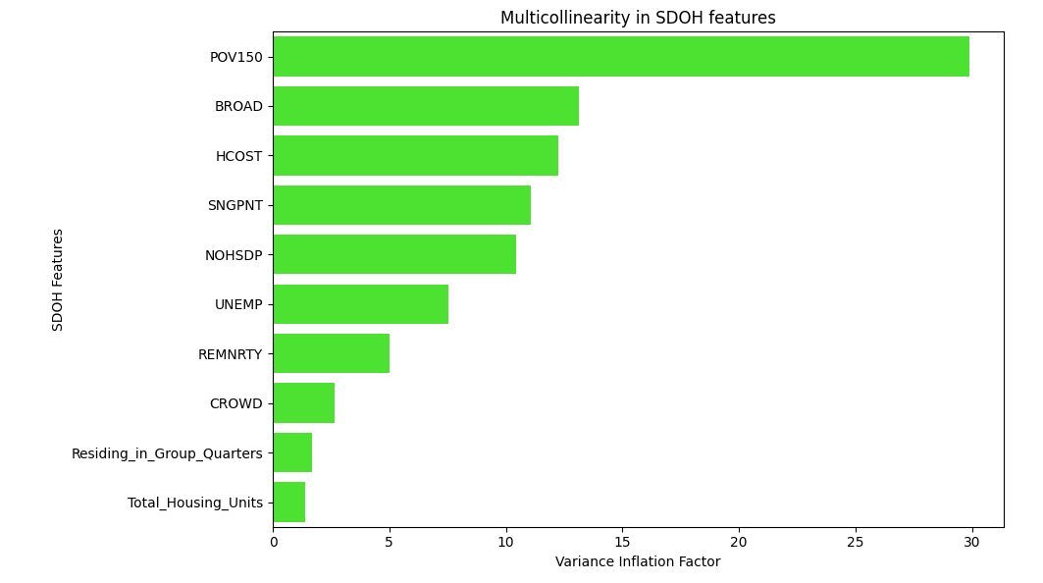
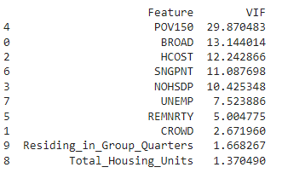
Checking for Multicollinearity in SDOH Features

Slide 17
MACHINE LEARNING

Slide 18
USED TECHNIQUES
Logistic Regression
Linear model
Neural Networks
Interconnected layers of neurons
Map data for a desired output
Random Forest
Builds multiple decisión trees
Used in classification and regression tasks
Binary Classification
Used for binary and non-binary data
Inputs > Act. Function > Outputs

Slide 19
LOGISTIC REGRESSION *JUPYTER NOTEBOOK

Slide 20
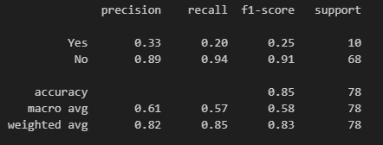
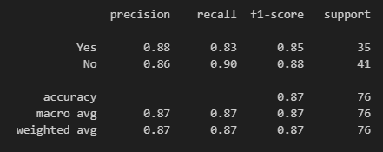
LOGISTIC REGRESSION Confusion matrix
Lung Cancer
Heart Attack
True Positives (Yes are actual Yes):
2/10 correctly identified.
False Negatives (No are actual Yes):
8 lung cases missed.
True Negatives (No are actual No):
64/68 correctly identified.
False Positives(Yes are actual No):
4 cases incorrectly classified.
True Positives (Yes are actual Yes):
29/35 cases correctly identified.
False Negatives (No are actual Yes):
6 cases were missed
True Negatives (No are actual No):
37/41 cases correctly identified
False Positives(Yes are actual No):
4 cases incorrectly classified

Slide 21
Used parameters
ACTIVATION FUNCTIONS
OPTIMIZERS
ReLU: Simple and efficient. Activates only positive inputs.
Leaky ReLU: A modified ReLU that allows a small, non-zero gradient for negative inputs.
ELU: Unlike ReLU, ELU allows negative inputs, helping to make the mean activations closer to zero
PReLU: A variant of Leaky ReLU, but with the slope of the negative part of the function being a learnable parameter
Swish: A smooth, non-monotonic function that outperforms ReLU in certain deep networks. Swish allows for small negative inputs
Adam: Widely used, computes individual rates for each parameter.
Adamax: More stable versión of Adam.
RMSprop: handles non-stationary objectives.
SGD: Gradient descent updating weights by the loss function.

Slide 22
Neural networks *JUPYTER NOTEBOOK

Slide 23
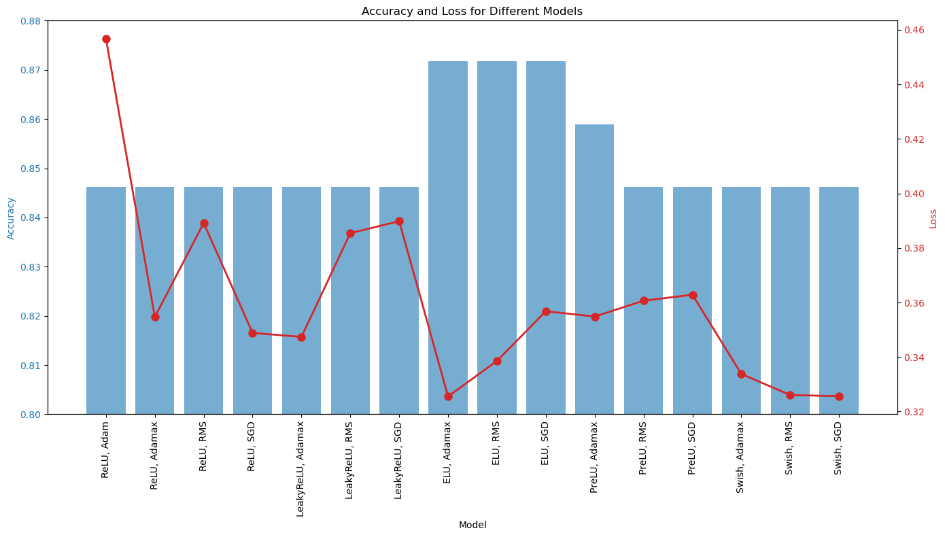
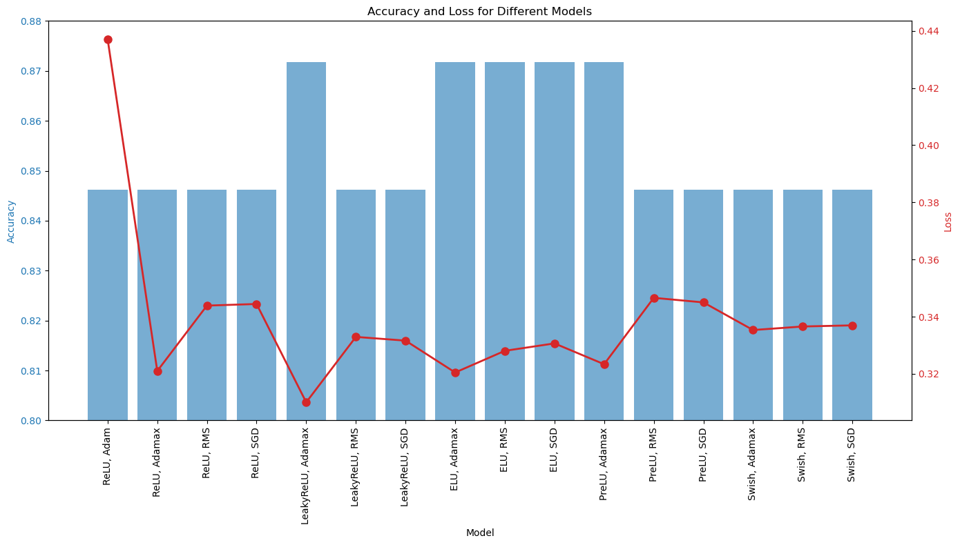
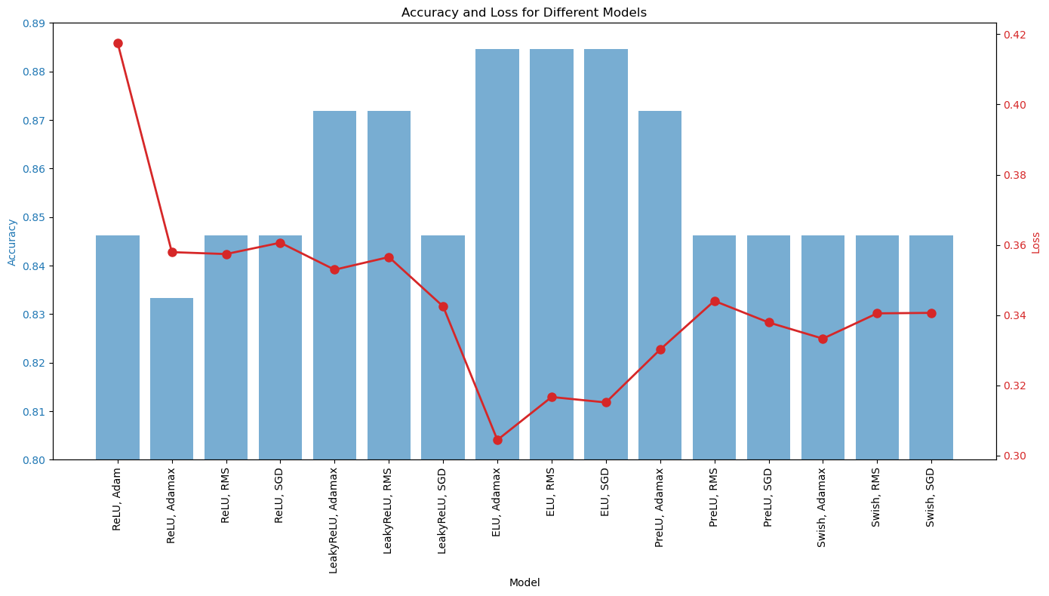
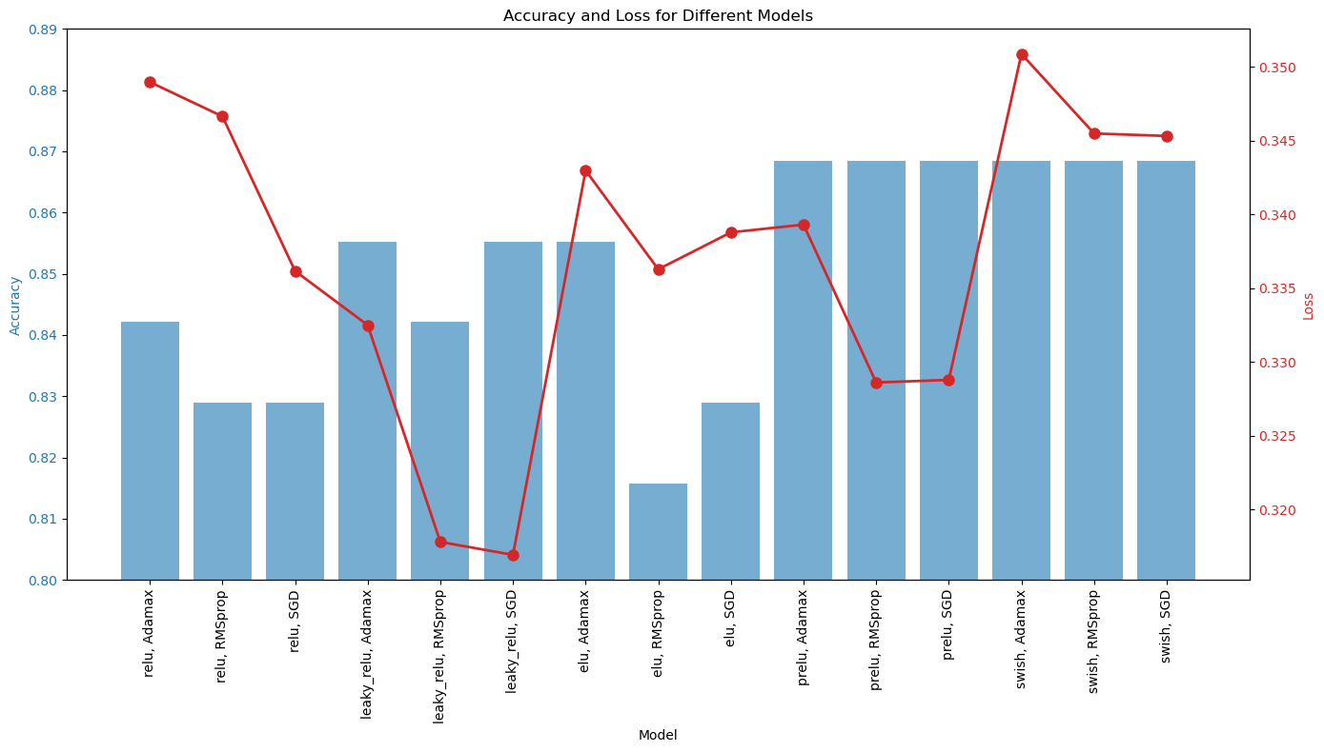
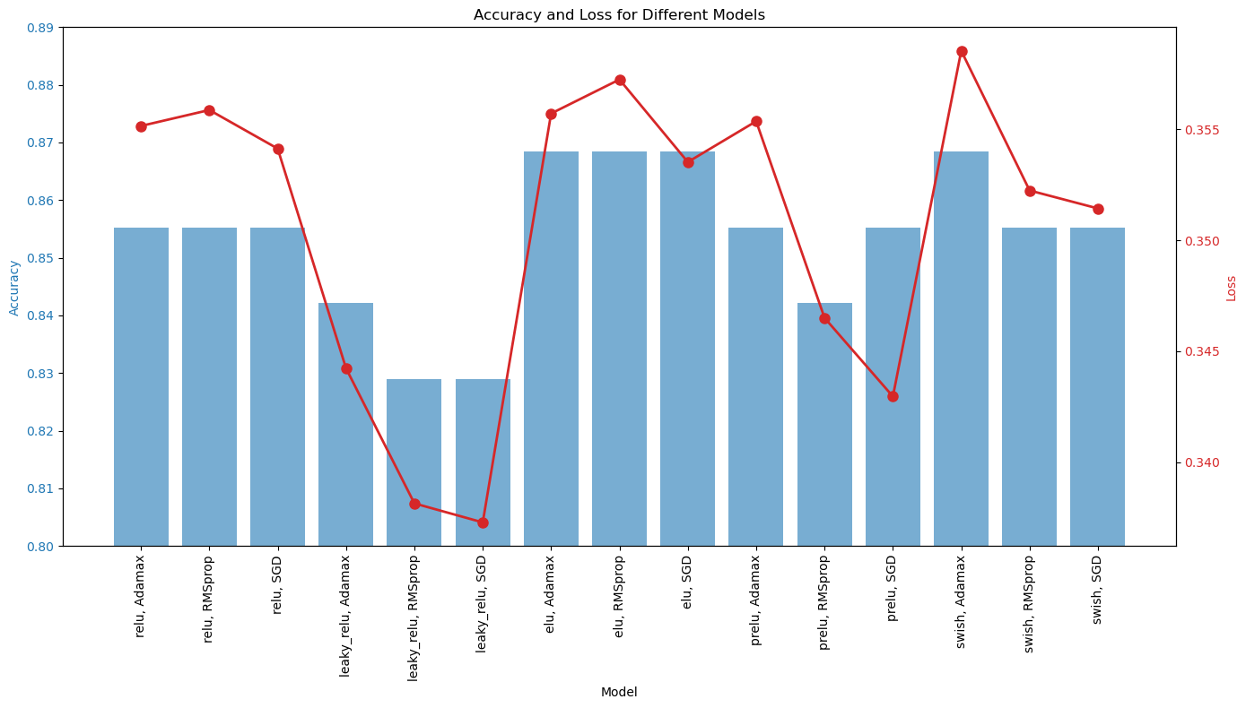
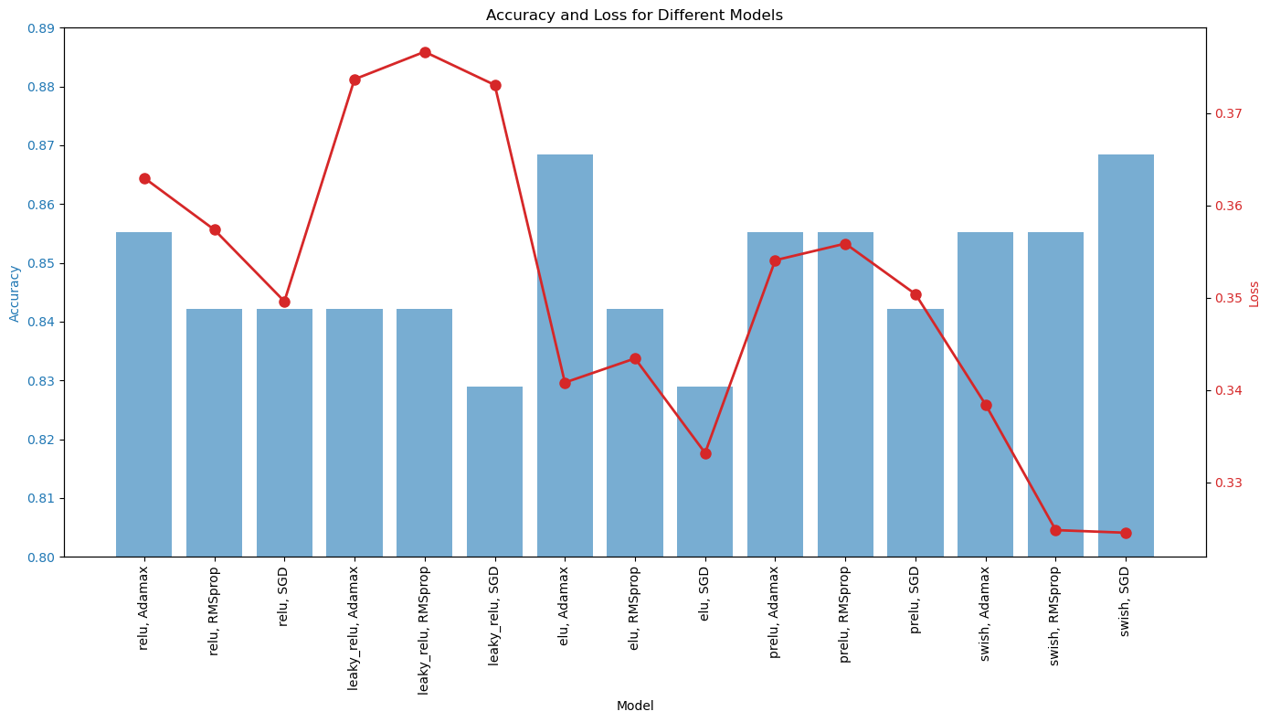
Lung cancer (elu, aDAMAX)
Heart attack (PRELU, SGD)***

Slide 24

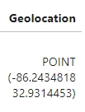
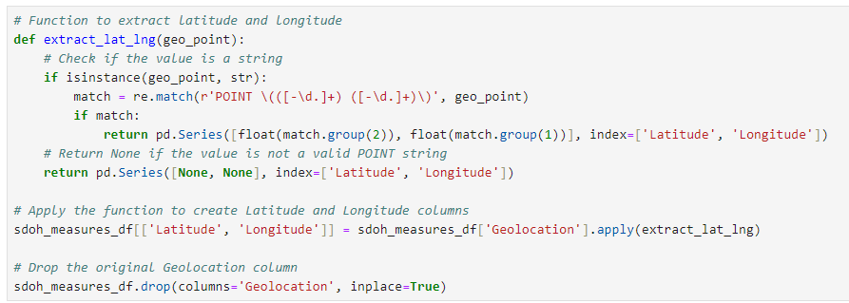
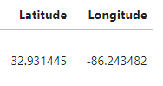
Data Cleaning and Database Prep
SDOH Measures for County, ACS 2017-2021
data.cdc.gov

Slide 25
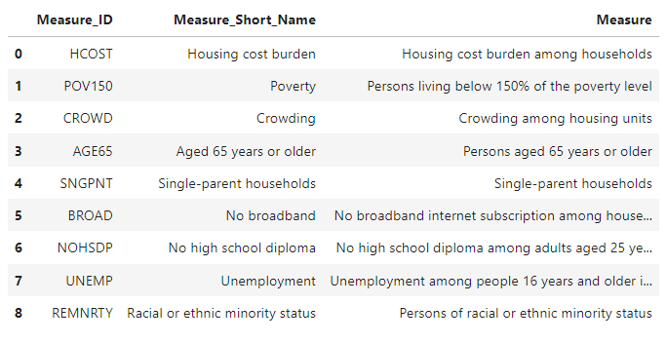
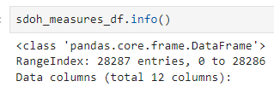
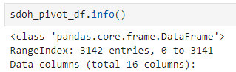
Data Cleaning and Database Prep
SDOH Measures for County, ACS 2017-2021
data.cdc.gov

Slide 26
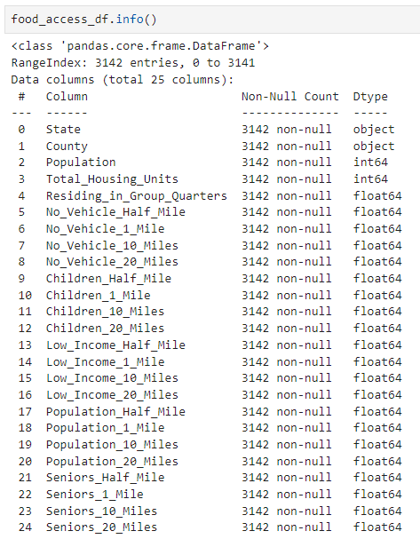
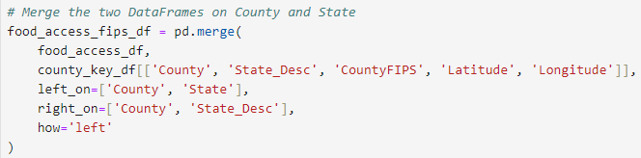
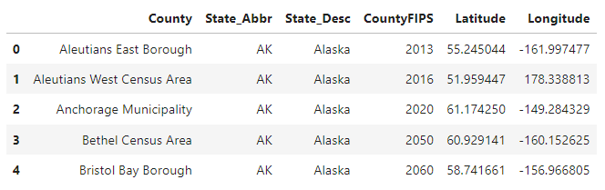
Data Cleaning and Database Prep
🍕US Food Access
www.kaggle.com/datasets

Slide 27
Data run through neural network optimizer function
Features
Housing cost burden among households
Persons living below 150% of the poverty level
Crowding among housing units
Persons aged 65 years or older
Single-parent households
No broadband internet subscription among households
No high school diploma among adults aged 25 years or older
Unemployment among people 16 years and older in the labor force
Persons of racial or ethnic minority status
Without vehicle count beyond 10 miles from supermarket
Without vehicle count beyond 1 mile from supermarket
Without vehicle count beyond a half mile from supermarket
Targets
Diabetes
Chronic Heart Disease
Cancer

Slide 28
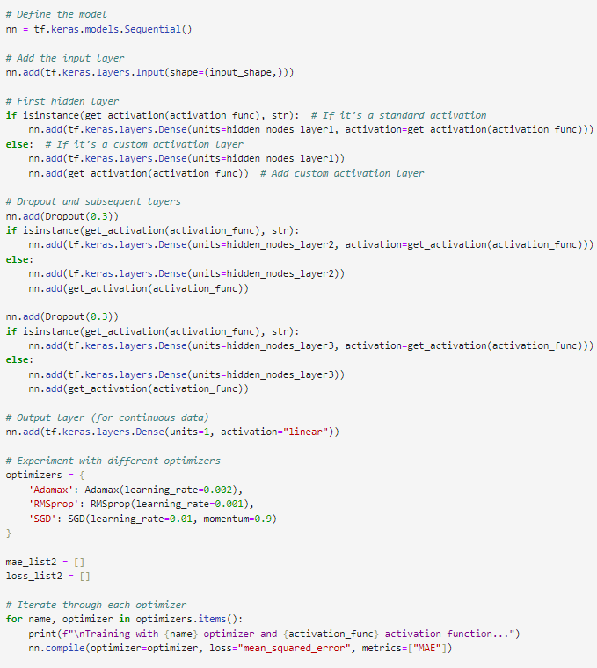
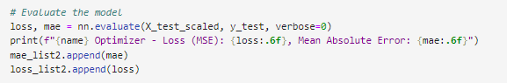
Change Function to Work with Continuous Data
Output Layer Activation
Loss Function and Metrics
Evaluate MAE
Variables to Adjust to Different Datasets
input_shape
hidden_nodes_layer1
hidden_nodes_layer2
hidden_nodes_layer3
Notes:
Circled in Red –
Output layer activation function - changed from ‘sigmoid’ to ‘linear’
Loss Function – changed from ‘binary_crossentropy’ to ‘mean_squared_error’
Appropriate loss functions could be Mean Squared Error (MSE) or Mean Absolute Error (MAE)
I chose Mean Squared Error because it is more sensitive to large errors since it squares them. It encourages the model to reduce large deviations
Metrics – changed from ‘accuracy’ to ‘MAE’
Including MAE in metrics gives us an idea of the average magnitude of errors in the same units as the target variable
Since MAE was used in .complie we use it in .evaluate

Slide 29
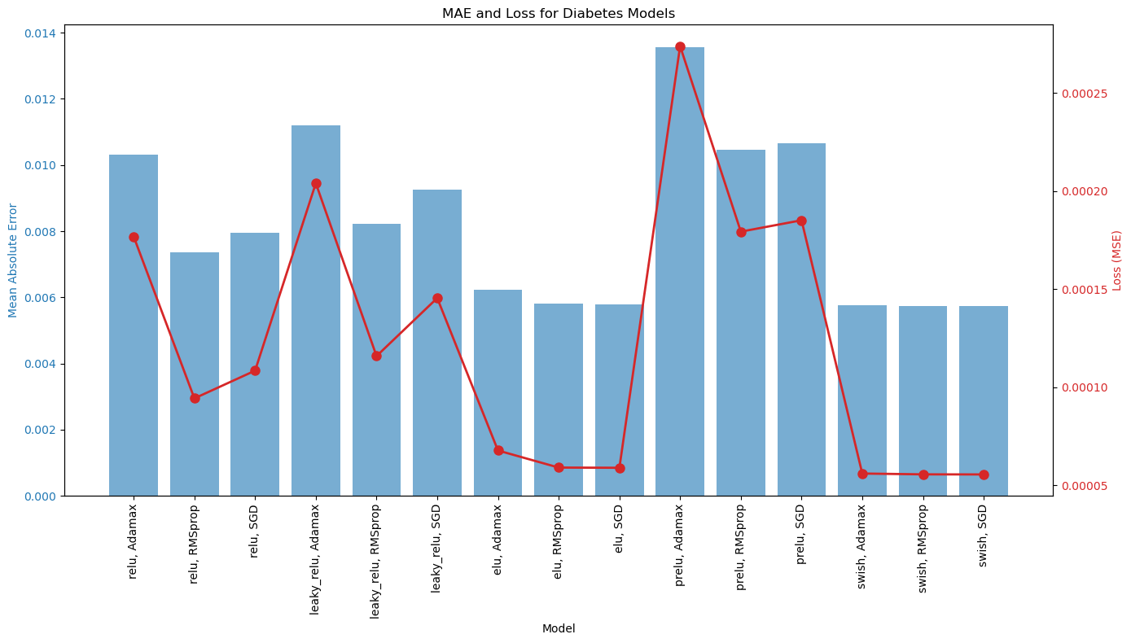
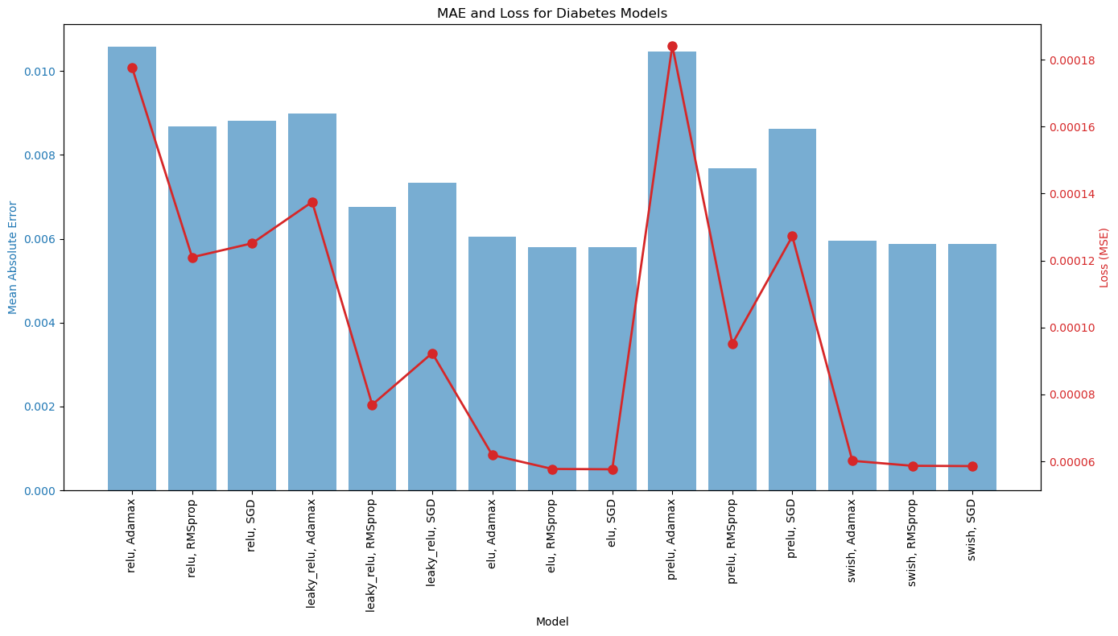
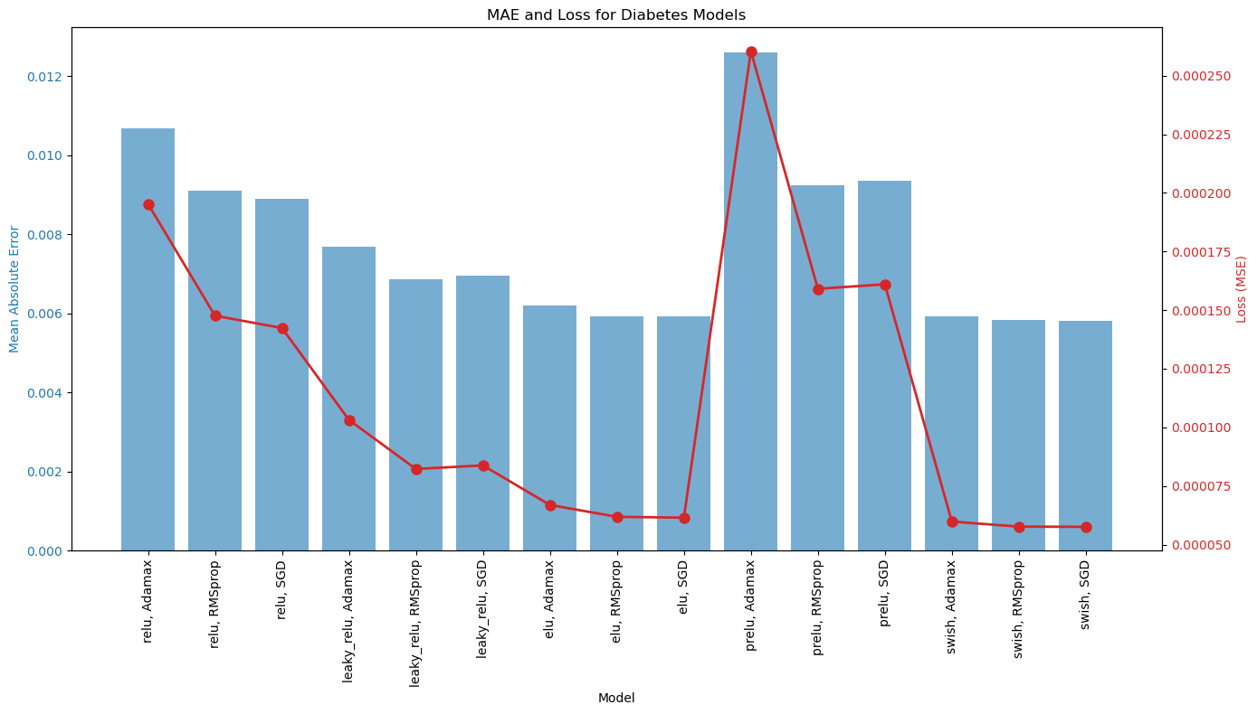
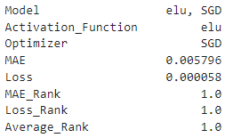
Diabetes Optimization Function
Model Optimization
Activation Function: Exponential Linear Unit (elu)
Optimizer: Stochastic Gradient Descent (SGD)
Model Performance
MAE 0.005796
Loss (MSE) 0.000058
Notes:
(ELU) is an activation function that helps the model learn complex patterns. This can lead to faster learning and improved performance.
(SGD) Is a basic optimization algorithm. While it is often slower and less efficient than more advanced optimizers like adam, it can sometimes yield better results.
MAE 0.005796 – Predictions are within 0.58% of actual value
Loss (MSE) 0.000058 – Indicates the model has learned the training data well

Slide 30
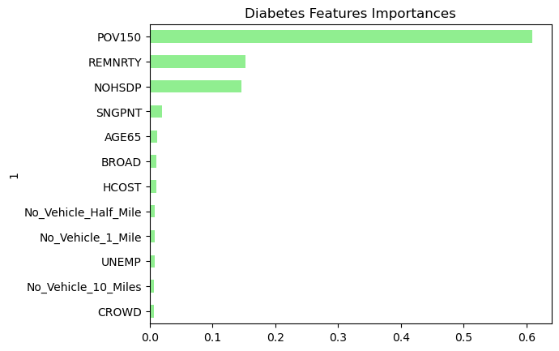
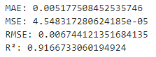
Diabetes Random Forest Regressor Evaluation Metrics
Notes:
MAE and MSE are similar values to what we found in the neural network
RMSE – Root Mean Squared Error provides an error metric in the same units as the target variable
R2 – represents the how much of the variance in the target can be explained by the model.
91.7% suggests high predictive ability
POV150 - Persons living below 150% of the poverty level
REMNRTY - Persons of racial or ethnic minority status
NOHSDP - No high school diploma among adults aged 25 years or older

Slide 31
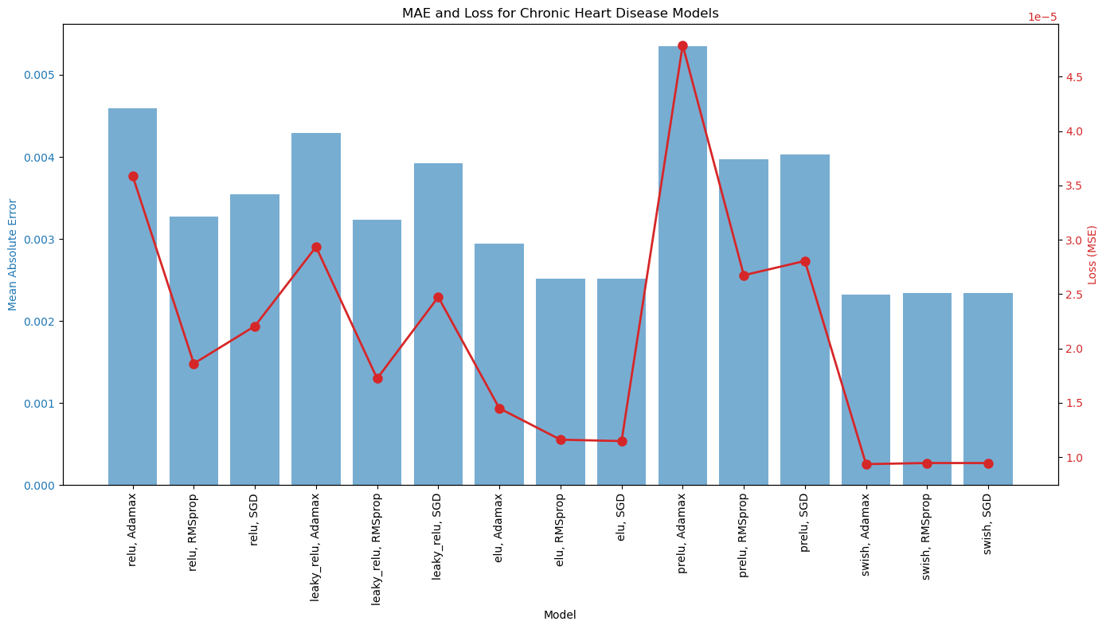
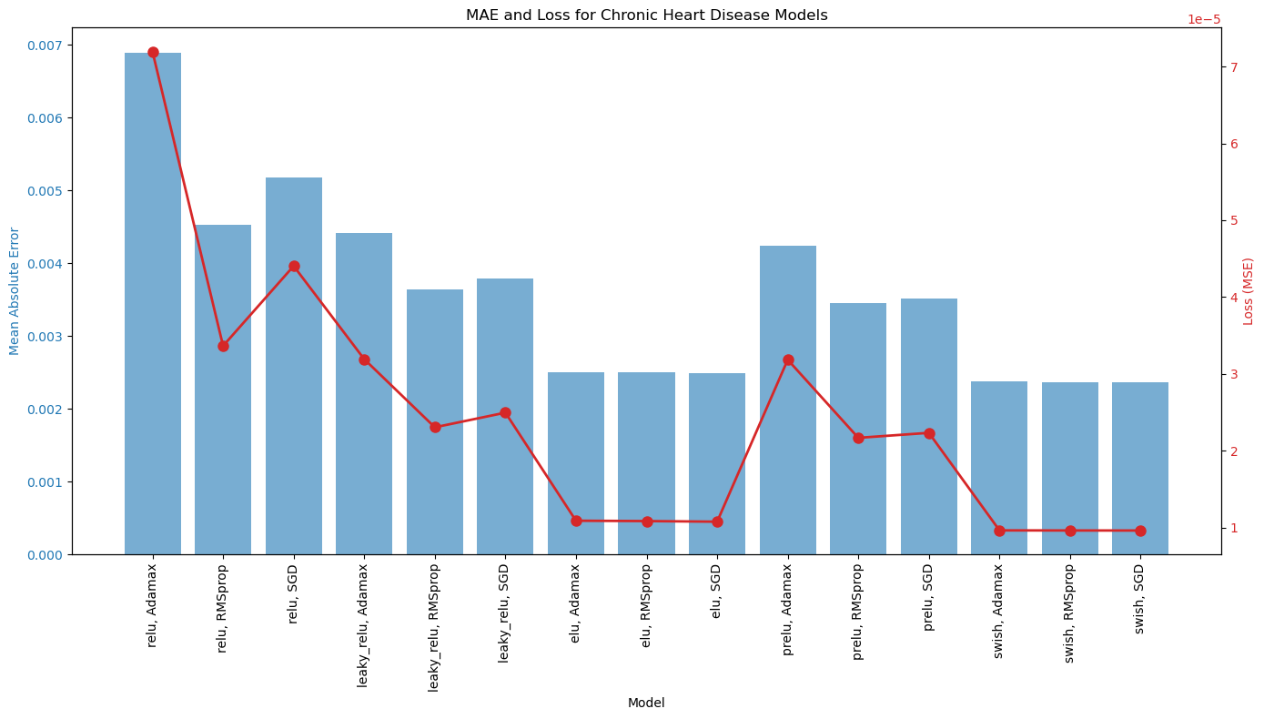
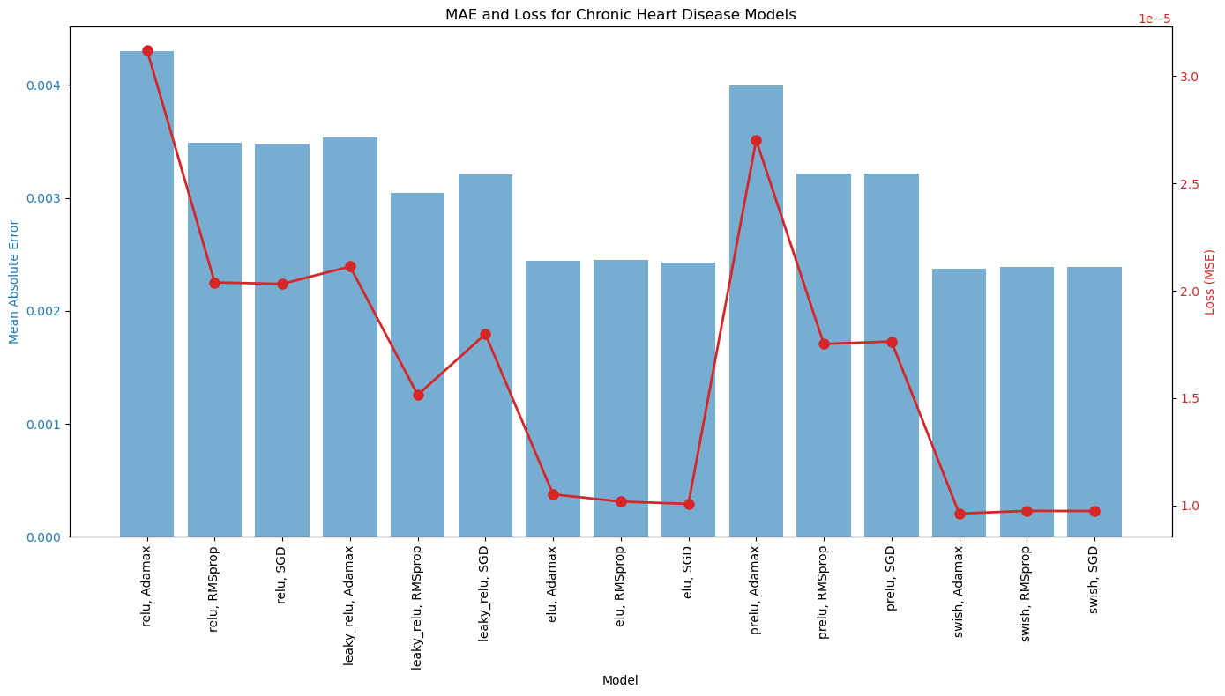
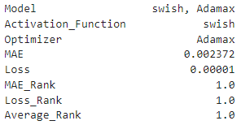
Chronic Heart Disease Optimization Function
Model Optimization
Activation Function: Swish
Optimizer: Adamax
Model Performance
MAE 0.002372
Loss (MSE) 0.00001
Notes:
Swish often outperforms traditional activation functions because it is non-monotonic, allowing more flexible learning
Adamax is a variant of the Adam optimizer. It is generally more stable and has been shown to work well for deep learning models
MAE 0.002372 – Predictions are within .24% of the actual value
Loss (MSE) 0.00001 – Indicates the model has learned the training data well

Slide 32
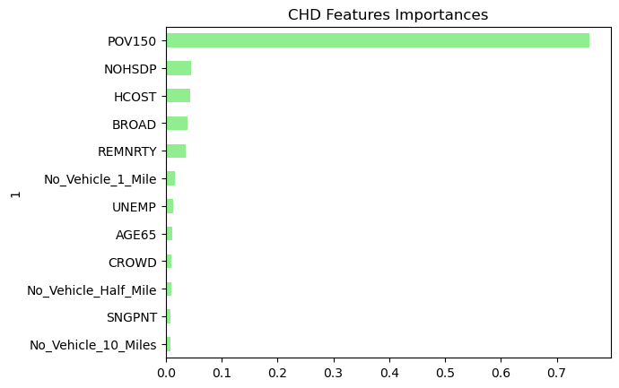

Chronic Heart Disease Random Forest Regressor Evaluation Metrics
Notes:
MAE and MSE are similar values to what we found in the neural network
RMSE – Root Mean Squared Error provides an error metric in the same units as the target variable
R2 – represents the how much of the variance in the target can be explained by the model.
88.2% suggests high predictive ability
POV150 - Persons living below 150% of the poverty level
NOHSDP - No high school diploma among adults aged 25 years or older HCOST - Housing cost burden among households
BROAD - No broadband internet subscription among households
REMNRTY - Persons of racial or ethnic minority status

Slide 33




Cancer Optimization Function
Model Optimization
Activation Function: Swish
Optimizer: RMSprop
Model Performance
MAE 0.000948
Loss (MSE) 0.000002
Notes:
Swish often outperforms traditional activation functions because it is non-monotonic, allowing more flexible learning
RMSprop is an adaptive learning rate optimizer designed to handle noisy and non-stationary data
MAE 0.000948 – Predictions are within .09% of the actual value
Loss (MSE) 0.000002 – is extremely low, suggesting that the model is highly efficient at minimizing prediction errors

Slide 34


Cancer Random Forest Regressor Evaluation Metrics
Notes:
MAE and MSE are similar values to what we found in the neural network
RMSE – Root Mean Squared Error provides an error metric in the same units as the target variable
R2 – represents the how much of the variance in the target can be explained by the model.
84.8% suggests high predictive ability
REMNRTY - Persons of racial or ethnic minority status
CROWD - Crowding among housing units
NOHSDP - No high school diploma among adults aged 25 years or older

